Slide 1
2023 IERCD Urban Agriculture Subaward Program
Informational Webinar: Tracks 1 & 2

Slide 2
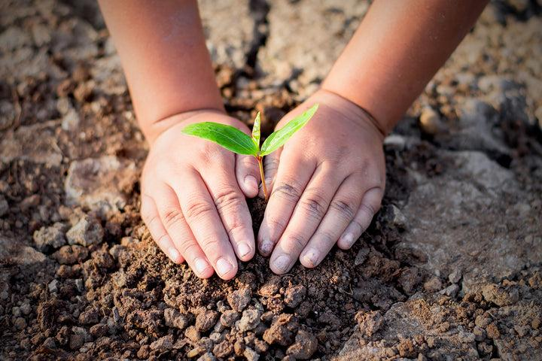
Topics Covered
Brief Background on Subaward Program
Overview of each funding track including:
  Purpose, eligibility, ranking criteria, application questions
Timeline
Reporting
Payment
  Allowable costs, reimbursement
Q/A
Notes:
Please type your questions in the chat and we will be having a designated Q/A portion at the end for any additional questions

Slide 3
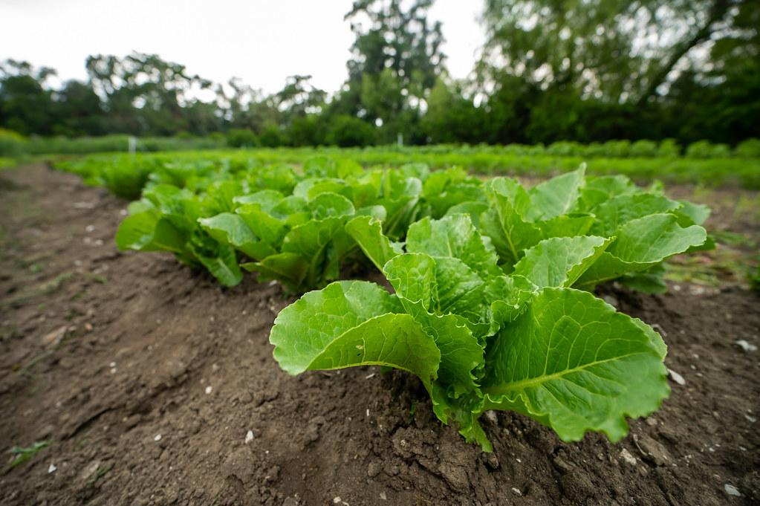

The purpose
Provide funding to address critical urban agricultural project needs and help achieve our communities’ goals for more green spaces, healthy food, and community engagement
Promote the establishment of new urban agriculture projects and support existing sites in underserved communities to promote healthier, more vibrant places.
Notes:
We received funding from CDFA for this urban grant program to administer subawards in our district to fund urban ag projects
Priority populations

Slide 4
Urban Agriculture Definition
Urban Agriculture refers to the cultivation, processing, and distribution of agricultural products in urban settings, including things like in-ground small plot cultivation, raised beds, vertical production, warehouse farms, mushroom growing, urban forestry and tree care, community gardens, rooftop farms, hydroponic, aeroponic, and aquaponic facilities, and other innovations. Urban farmers and gardeners work among diverse populations to expand access to nutritious foods, foster community engagement, offer workforce development opportunities, educate communities about food and farming, and expand green spaces.
An Agricultural operation must be located in a city with a population of at least 50,000 people or located within 25 miles of a surrounding city with a minimum of 50,000 people to qualify as urban

Slide 5
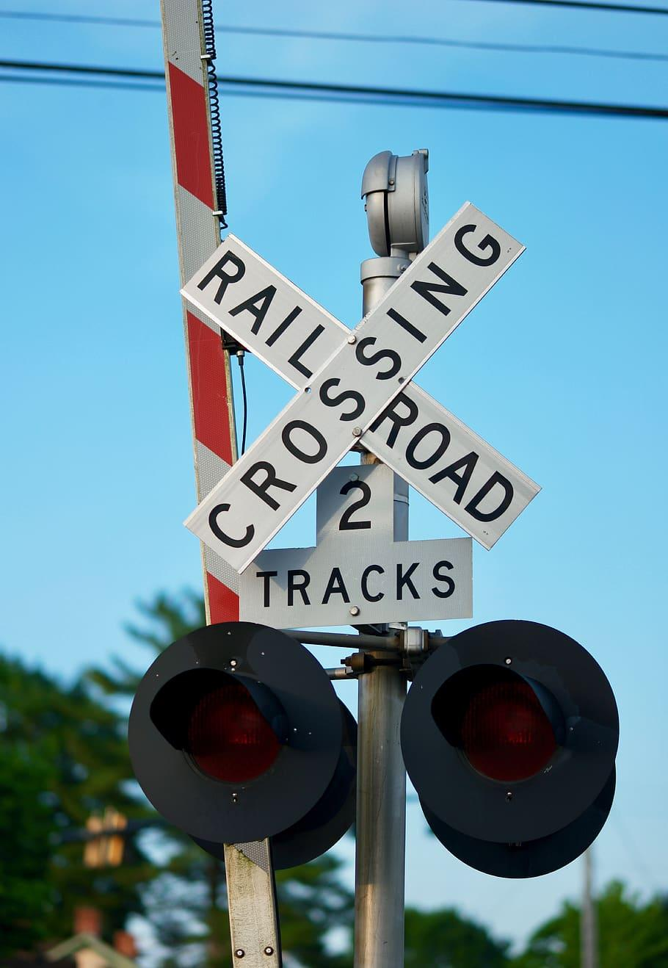
Two Funding Tracks
Track 1: Farmer Infrastructure and Equipment Subgrant Program
Track 2: Community Partner Subgrant Program
Please note you can only apply to one track even if you are eligible for both
Notes:
We will be going over the difference between the two and please apply to the track that best matches your eligibility and project needs

Slide 6
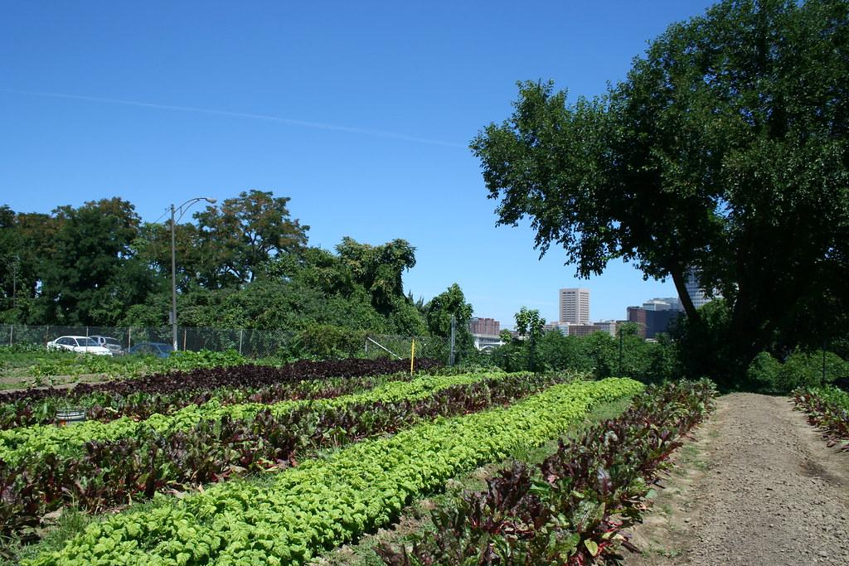
Track 1: Urban Farmers

Slide 7
Track 1: Purpose
Support urban farmers that operate a for profit business within IERCD’s district boundary
Connect urban farmers with essential equipment and infrastructure purchases to optimize farming operations
Increase the regional supply chain for fresh and local produce
Provide funding for eligible projects between $5,000-$30,000
Notes:
Eligible projects such as community gathering spaces, shade structures, farm stand, CSA, Tools, solar panels for more examples of eligible projects please refer to the IERCD website (add in chat) reminder this list is not comprehensive so if you have a need or idea that is not listed please feel free to reach out to a IERCD staff member

Slide 8
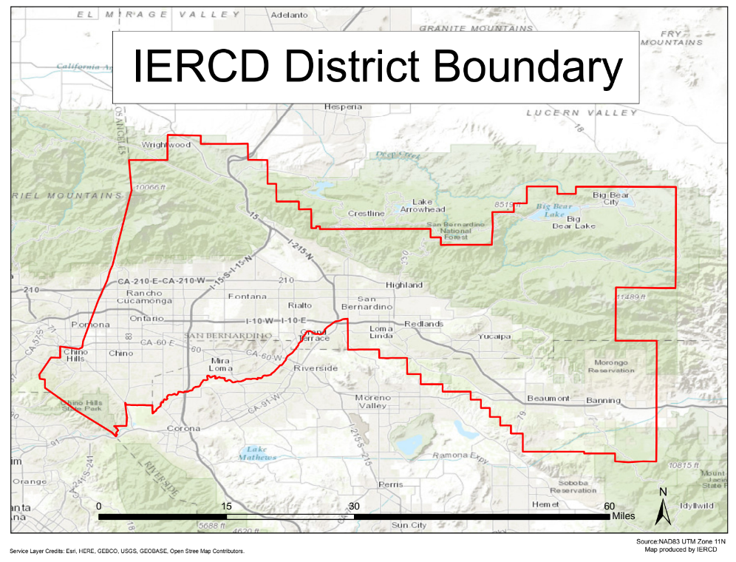
Track 1: Eligibility
The farm must be located within IERCD’s District Boundary
The farmer must sell produce for a profit with a minimum of $1,000 in produce sales annually
The farmer must either own the land or have an active lease of at least 1 year
Notes:
Nonprofit farms are not eligible for this program track, but will be eligible for Track 2
If you are outside of our district boundary we encourage you to connect with Los Angeles Food Policy Council (Los Angeles) , San Diego Center for Community health (San Diego), Agroecology Commons (Bay Area), Asian Business Institute and Resource Center (Fresno), Community Alliance with Family Farms (Statewide)

Slide 9
Track 1: Ranking Criteria
The extent to which the project increases the capacity of the farm to support the regional food system
The populations that the farm serves. Priority will be given to farms that serve and distribute produce to priority populations within the Inland Empire
Reasonableness of the financial request for the items requested in the application
The demonstrated financial need of the farm
Notes:
What the review committee will use to score and compare projects - please make sure to keep these criteria in mind when completing your application and ensure all are discussed in detail
Priority population refers to a low income or disadvantaged community within IERCDs district boundary

Slide 10
Track 1: Application Overview
Section 1 | General Contact Information
Section 2 | Farm Information
Section 3 | Financial Need
Section 4 | Capacity
Section 5 | Project Proposal
Section 6 | Budget
Section 7 | Timeline
Notes:
Section 2: size of farm, crops grown, populations served
Section 3: total gross revenue, previous funding received if applicable, portion of income derived directly from operation
Section 4: capacity referring to how this purchase will not only improve farming operations at your site, but how it will also increase your ability to serve priority populations in the IE - ex more produce to be sold at farmers markets or farm stands available to the surrounding community
Section 5: please describe your project in detail and what the purchases will be used for. Explain how this purchase will improve your farming operations and your ability to increase the regional food supply
Section 6: please use the attached budget chart to fill out the equipment/ infrastructure requested including the price, and number of units needed
Section 7: date when the project will be completed by
Please note all sections must be completed for your application to be reviewed

Slide 11
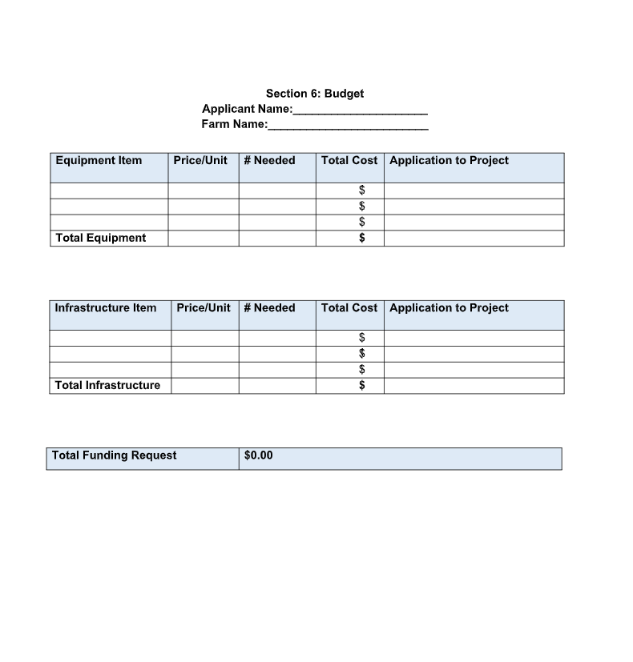
Track 1: Required Attachment (1)
Please download and attach the budget sheet before submitting your application
Please reach out to IERCD staff for technical assistance if needed

Slide 12
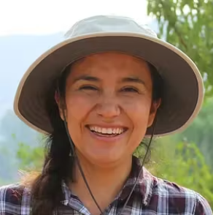
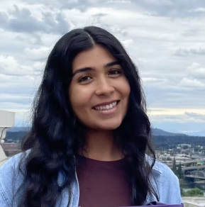
Track 1: Support Contacts
Lucy Ceja
Sustainable Agriculture Specialist
lsolorzano@iercd.org
Madison Santiago
Sustainable Ag Lead
Please contact us for help with creating and submitting your application!
msantiago@iercd.org
Options for support:
Zoom call
Site visit
Phone call
Notes:
If google forms and online documents aren't for you, we offer a downloadable pdf form of the application which can be filled out and emailed to Lucy or myself who can help transcribe the information onto the google form

Slide 13
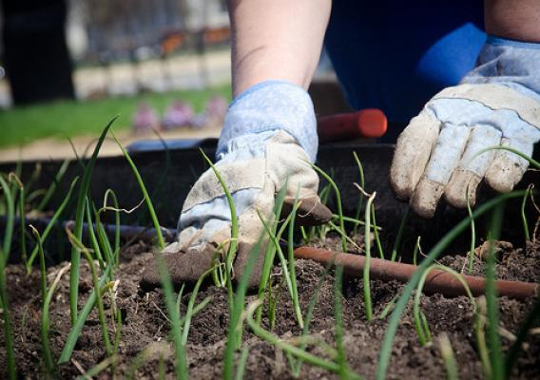
Track 2: Community Partners

Slide 14
Track 2: Purpose
Support non-profit or community-based urban farms/gardens within IERCD’s district boundary
Provide funding for a variety of capacity building needs including: workforce development, technical assistance and operations, community engagement and education efforts, project infrastructure and equipment.
  Funding pool between $5,000-$60,000
Encourage community projects that contribute one or more of the benefits of urban agriculture
  Builds social capital and gathers communities
  Provides educational and skills development
  Supplements access to fresh food
  Cultivates Agricultural literacy
  Performs ecosystem services
  Supports economic development
  Increases food sovereignty
  Pilots an innovation in production
Notes:
Projects can fall within 5 categories: specific examples of projects within each category can be found on our website. Reminder this list is not comprehensive so if you have a need or idea that is not listed please feel free to reach out to a IERCD staff member
Benefits including - increase food sovereignty, performs ecosystem services, provides educational and skills development, gathers communities

Slide 15
Track 2: Eligibility
The proposed project must be located within IERCD’s District Boundary OR support projects that are located within IERCD’s District.
Eligible applicant types:
  501(c)(3) non-profits
  For-profit organizations and businesses
  Tribal governments and tribal-based nonprofits operating an urban agriculture project
Project must accomplish one or more of the following program goals:
  Be led by and or serve an urban underserved community as determined by CalEnviroScreen
  Demonstrate community engagement practices.
  Support the viability of urban food cultivation, processing, or distribution.
  Pilot an innovation in production such as but not limited to mushroom propagation, aquaponics, aeroponics, hydroponics, rooftop gardens or warehouse farms.
  Provide employment development opportunities, especially youth employment and development opportunities.
  Provide educational opportunities as it relates to growing or consuming locally grown seasonal produce.
  Provide urban greening, habitat restoration and environmentally beneficial services such as but not limited to planting hedgerows, native plant gardens or food forests.
Notes:
Federal, State, and Local Governments are ineligible - however an eligible applicant from the list i just mentioned located on gov land would still be eligible
School gardens are not eligible for this program and should instead apply to The California Farm to School Program. This includes public and private schools as well as universities
Priority population = disadvantaged or low income communites

Slide 16
Track 2: Ranking Criteria
The extent to which the project describes a need in their community and connects how their project will fulfill or support that community need.
The populations that the project serves. Priority will be given to projects that clearly explain how their project will support priority populations within the Inland Empire
The strength of the project team in meeting the proposed project deliverables
Reasonableness of the financial request for the items requested in the application
Overall level of detail and thought put into the proposal
Notes:
What the review committee will use to score and compare projects - please make sure to keep these criteria in mind when completing your application and ensure all are discussed in detail
Priority population = disadvantaged or low income communites
Strength of project team referring to experience in managing past funding and or sufficient number of staff members to accomplish the desired project goals within the specified time frame
Reminder this is a competitive grant and we want to ensure we can fund as many great projects as financially possible

Slide 17
Track 2: Application Overview
Section 1 | General Contact Information
Section 2 | Organization Background and Capacity
Section 3 | Community Engagement and Populations Served
Section 4 | Project Staff Summary
Section 5 | Project Description
Section 6 | Project Goals and Objectives
Section 7 | Outcomes and Timeline
Section 8 | Budget
Section 9 | Applicant Certification
Notes:
Section 2: organization type, organizations mission and experience with urban agriculture, and current partnerships
Section 3: the priority population served and engagement strategy as well as how project will address specific needs of local community
Section 4: using the provided table accessible through the project staff table link - include only the primary individuals involved in the project including their role and past experience with other similar projects
Section 5: detailed description of the project and how the award will be used. The more detail the better help us to see the vision you have for your project and how this award can make that happen
Section 6: check all CDFA Urban Ag Grant Program goals that your project will address (8 options). At least one must apply but please only check the goals that directly apply. All chosen goals need to be briefly explained to illustrate how they will be addressed. Please note checked goal that are not clearly addressed will not be considered (The amount of goals that are checked will not influence your application consideration - projects will be evaluated based on the ranking criteria.
Section 7: Using the provided outcomes and timeline table on the application describe the measurable outcomes [end result of the activity]of the project and the steps that will be taken to accomplish them as well as the anticipated completion date of each step (month year), additionally note how the project will continue after funding is complete
Section 8: full financial cost of project, using the provided budget table please break down all costs including staff time, travel and equipment used , - reminder match funding is not required but list any additional funding sources if applicable
Section 9: certification of previously provided information, inquiry about TA needed to accomplish the project by IERCD staff and reminder to reach out to staff for assiatance
Please note all sections must be completed for your application to be reviewed

Slide 18
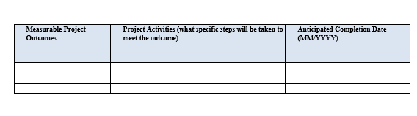
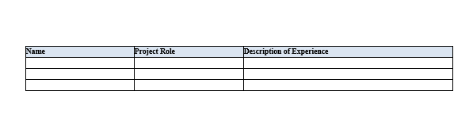
Track 2: Required Attachments (3)
Please download and attach the 3 documents listed before submitting your application
Please reach out to IERCD staff for technical assistance if needed
Budget Template
Outcomes and Timeline
Project Staff Summary

Slide 19
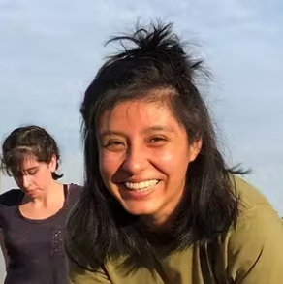
Track 2: Support Contacts
Autumn Yanez - Jacobo
Agriculture Programs Technician
ayanezjacobo@iercd.org
Madison Santiago
Sustainable Ag Lead
Please contact us for help with creating and submitting your application!
msantiago@iercd.org
Options for support:
Zoom call
Site visit
Phone call

Slide 20

Timeline
Track 1:
Applications due December 6th, 2024 5pm PST
Review period begins in December 2024
Awardees will be notified in January 2025
Projects completed by June 30, 2026
Track 2:
Applications due December 13th, 2024 5pm PST
Review period begins in December 2024
Awardees will be notified in January 2025
Projects completed by September 30, 2026
Notes:
Reminder: please make sure all questions are answered completely before submitting application and please feel free to reach out for any questions of technical assistance on your application

Slide 21
Reporting
Invoice
Summary
Photos
Provide the financial record of the material purchased and/ or assembled.
Include information such as the type of purchase, quantity, price and date.
At least one invoice is required, but multiple can be submitted throughout the project’s timeline at the frequency that best supports the project partner
Provide a brief written record of project updates and accomplishments
Include numerical data if applicable
*Track 2 must include an update on the project’s timeline and note any challenges that may delay anticipated completion date
Provide visual documentation of the material purchased
Include at least (2) photos
Notes:
Track 1 and 2 awardees will be asked to report on their projects by providing an invoice, summary, and photos to IERCD staff
Numerical data such as number of volunteers at a community garden planting event
Staff can help support projects that may have encountered a problem and provide support

Slide 22
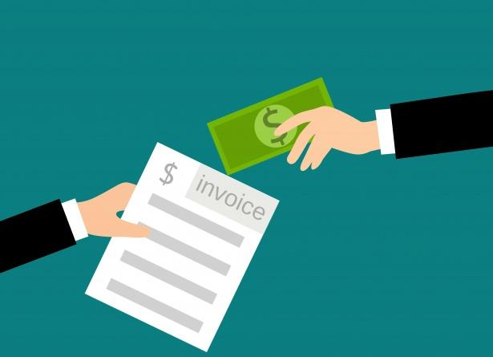
Payment
Allowable costs:
  Direct cost - Track 1 & 2
  Indirect cost - Track 2 only (<30%)
Reimbursement:
  Items can be purchased in increments or all at once
  Purchases can be made directly by the project lead or by IERCD
  Invoices can be submitted quarterly or monthly as needed
  Standard reimbursement will occur about 30 days after invoice has been approved
    If you have a special financial circumstance please reach out to IERCD staff for more options
Notes:
All items listed in approved project budget sheet will be reimbursed
Direct cost - Expenses directly related to fundable project (ex. Shade structure)
Indirect cost - Expenses not directly related to fundable project but required to accomplish goal - only account for 30% less of award total (ex. Operational costs such as utilities, grant admin)
No matching funds required

Slide 23
Question & Answer
Notes:
No such thing as a bad question

Slide 24
Thank you for Attending!
Please fill out our survey in the chat
https://forms.gle/CqFWPjZ7RcrQNA5M9
Notes:
We Will be offering in person and virtual workshops to provide assistance on applications and answer questions as well as holding virtual office hours weekly. Available by email or phone as well

